Slide 1
Transportation And Air Quality Index In Lahore

Slide 2
Group Members:
Uzair Idrees (172/21pwciv5627)
Darya Khan (173)
Usman Hasrat (175)
Mustaeen Ullah Khan (176)
Ahmad Ullah Afridi (177)
Atif Rahim (178)

Slide 3
Background of problem
Bogotá, capital of Colombia, consist of a population of 6.5 million people, about 15% of the whole population of the country.
95% of the road network was used by 0.85 million private vehicles, which transported 90% of the population.
Close to 70% of trips shorter than 3km were made by cars.
Busses occupied a low percentage of roadway network.
Transportation system was operated by private operators, which prefer their benefits instead of giving better service to passengers, for their benefits they only increased bus supply and never look after for their maintenance and renovation.
This leads to high pollution level of 750,000 tons of atmospheric pollutants per year generated by traffic.

Slide 4
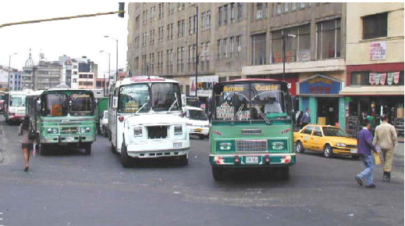
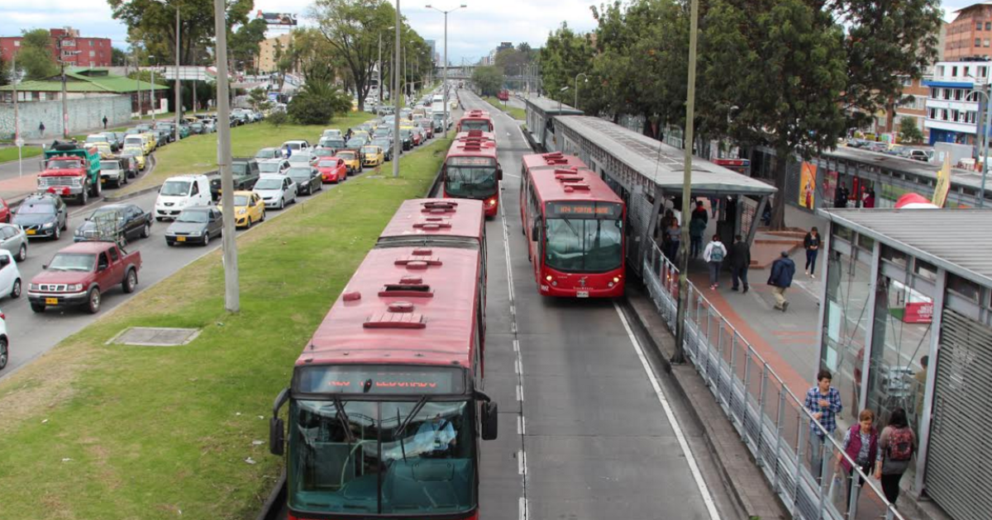
Google image of location where you seen the problem
Before the Implementation of BRT
After the Implementation of BRT

Slide 5
Problem Statement
Lack of efficient and quality public transport, increased car ownership, traffic congestion, difficulty of commuting for non-private car owners, excess of private transportation system which lacks quality of service and emission of tons of pollutant per year which leads to degradation of air quality due to poor transport system.

Slide 6
Implementation of Solution
Since 1998, the city has implemented some strategies to reduce congestion such as a reduction of 40% of the automobiles used.
Implementation of a bikeway network, and pedestrian walkways.
The creation of the Transmilenio BRT system.
Transmilenio is a high-capacity transportation system that provides the same quality of a LRT service.
In 2000, Transmilenio began operation.

Slide 7
Results
In December 18, 2001, the mayor of Bogotá, inaugurated the new BRT service in the city.
During phase 1 the BRT system moved an average of 770,000 passengers/day with 34,000 passengers per hour per direction on the busy sections of the system
The reductions in pollution and accidents as well as safety improvements were some of the most important impacts observed at the end of phase 1.
A monitoring study at the one of the main lines (Troncal Caracas) in 2000 and 2001 showed a reduction of about 43% of sulfur dioxide (SO2), 18% of Nitrogen Dioxide (NO2), and 12% of particulate matter of less than 10 microns (PM-10) (Hidalgo and Sandoval, 2001).
A reduction of 32% in the travel time for public transportation users was measured.

Slide 8
Conclusion about Solution
People are leaving their cars at home and users seem to accept and like the system.
Surveys in Colombia show that the 49% of the users find the system very good and another 49% find the system good during the first phase of operation.
The BRT system in Colombia can be taken as an example for other developing countries to follow in the future.

Slide 9
Hurdles in implementation of solution
Major hurdles in implementation:
lack of alignment among stakeholders.
traditional bias towards vehicle capacity expansions.
opposition from existing bus operators.
insufficient funding for adequate implementation.
rushed inauguration.

Slide 10
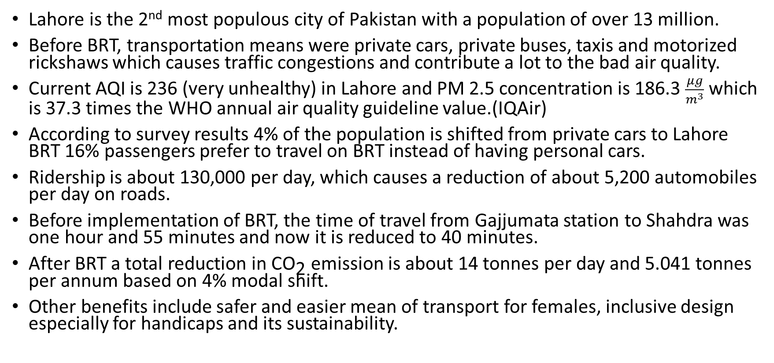
Comparison:
Lahore is the 2nd most populous city of Pakistan with a population of over 13 million.
Before BRT, transportation means were private cars, private buses, taxis and motorized rickshaws which causes traffic congestions and contribute a lot to the bad air quality.
Current AQI is 236 (very unhealthy) in Lahore and PM 2.5 concentration is 186.3 $\frac{μg}{m^{3}}$ which is 37.3 times the WHO annual air quality guideline value.(IQAir)
According to survey results 4% of the population is shifted from private cars to Lahore BRT 16% passengers prefer to travel on BRT instead of having personal cars.
Ridership is about 130,000 per day, which causes a reduction of about 5,200 automobiles per day on roads.
Before implementation of BRT, the time of travel from Gajjumata station to Shahdra was one hour and 55 minutes and now it is reduced to 40 minutes.
After BRT a total reduction in ${\text{CO}}_{\text{2}}$ emission is about 14 tonnes per day and 5.041 tonnes per annum based on 4% modal shift.
Other benefits include safer and easier mean of transport for females, inclusive design especially for handicaps and its sustainability.

Slide 11
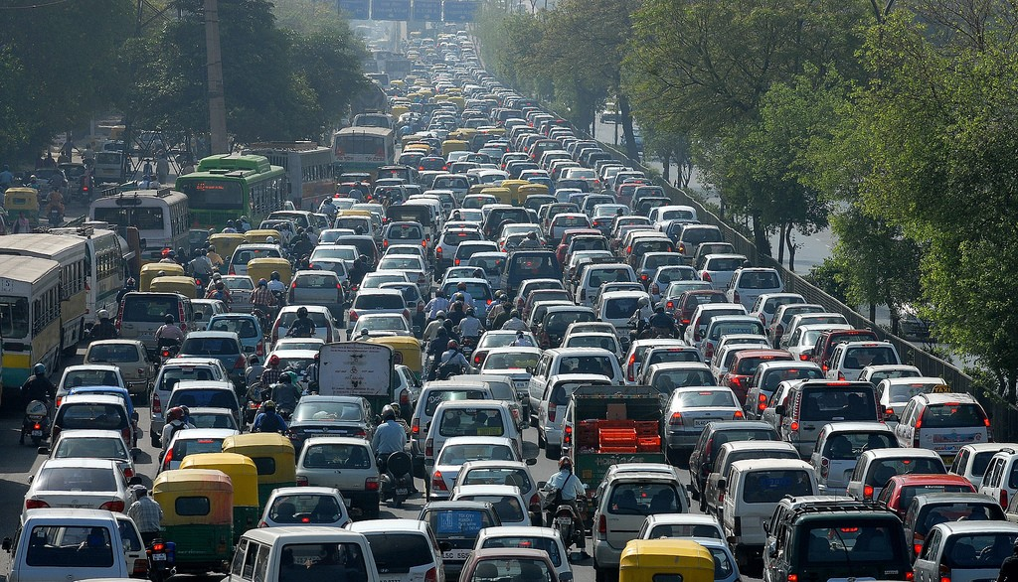
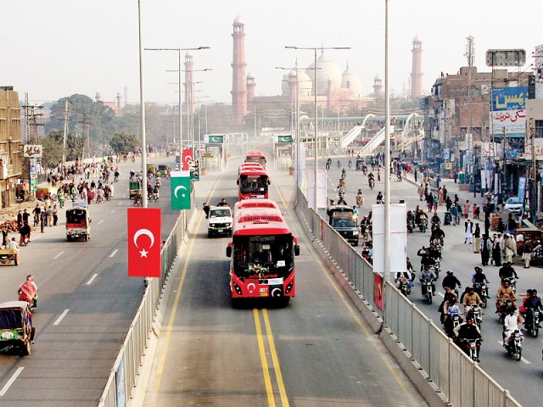
Before and After Picture of BRT Lahore

Slide 12
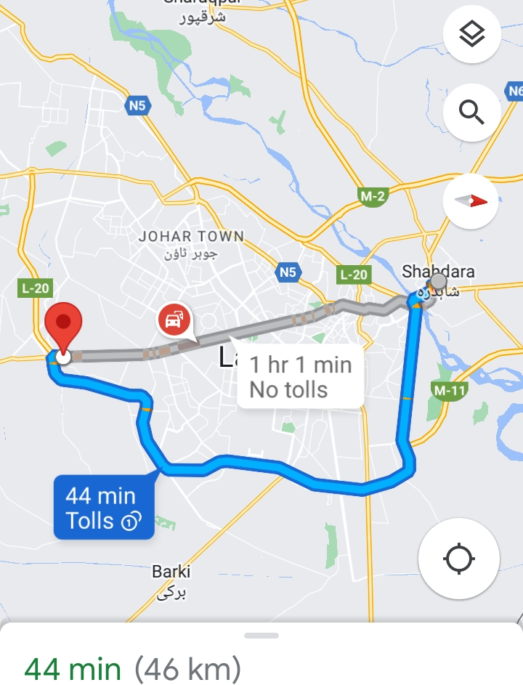
Gajjumata station to Shahdra
Blue line shows the route of metro Lahore which initiates from Gajjumata and terminates at Shahdra

Slide 13
Reference Links
The Lahore Journal of Economics (Spring 2020): 99.27-57, A Policy Move towards Sustainable Urban Transport in Pakistan: Measuring the Social, Environmental and Economic Impacts of Lahore BRT System.
Bus_Rapid_Transit_An_Alternative_for_Developing_Countries (https://www.researchgate.net/publication/228418187).
IQAir (https://www.iqair.com/pakistan/punjab/Lahore).

